Slide 1
Telecom churn analysis
CAPSTONE PROJECT
Presented By:
D.Divya
karpaga vinayaga college of engineering and technology
BIO-TECH department

Slide 2
OUTLINE
Problem Statement
Proposed System/Solution
System Development Approach
Algorithm & Deployment
output
Result
Conclusion
Future Scope
References

Slide 3
Telecom Churn Analysis
Analyzing customer churn in the telecom industry is vital for retaining customers and improving services. By understanding the reasons behind customer attrition, telecom companies can implement strategies to reduce churn rates and improve customer satisfaction.

Slide 4
Proposed Solution
Customer Segmentation
Predictive Analytics
Personalized Offers
Using data analytics for segmenting customers based on their behavior, preferences, and needs for targeted strategies.
Implementing predictive models to forecast customer behavior and identify potential churn risks early.
Creating customized offers and promotions for different customer segments to increase loyalty and retention.

Slide 5
System Approach
Data Collection
Collecting customer usage data, feedback, and demographic information for analysis purposes.
Model Development
Building machine learning models to predict customer churn and identify influential predictors.
Testing & Refinement
Testing the models and refining them based on their accuracy and effectiveness in predicting churn.

Slide 6
Algorithm & Deployment
Decision Trees
Logistic Regression
Implementing logistic regression to model the probability of customer churn based on various factors.
Using decision trees to identify the most significant predictors of churn and customer behavior.
Neural Networks
Developing neural network models to capture complex non-linear relationships in customer data.

Slide 7
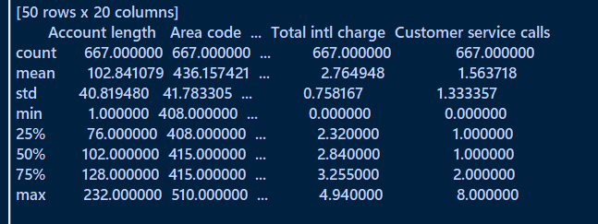
output

Slide 8
Result
1. Data Analysis
2. Churn Prediction
3. Insightful Visualization
Analyzing insights from the developed models to understand the factors contributing to churn.
Generating accurate predictions to identify customers at risk of churning in real-time.
Visualizing the churn trends and patterns to derive actionable strategies for retention.

Slide 9
Conclusion
Customer-Centric Approach
Continuous Improvement
Emphasizing the significance of customer preferences and feedback in reducing churn rates.
Recognizing the need for ongoing refinement and enhancement of churn prediction models and strategies.
Strategic Implementation
Implementing actionable insights derived from the analysis to improve customer retention effectively.

Slide 10



Future scope
Innovative Solutions
Expanding Reach
Enhanced Engagement
Exploring innovative technologies and solutions to further optimize churn analysis and reduction.
Expanding the scope of analysis to encompass a wider customer base and diverse demographics.
Enhancing customer engagement strategies based on personalized insights from the analysis.

Slide 11
References
1. Article: "Understanding Customer Churn in Telecom Industry"
2. Research Paper: "Predictive Modeling for Telecom Churn"
3. Book: "Data Analytics for Telecommunication"

Slide 12
THANK YOU

